Slide 1





DATA-Driven Analysis Report *PORTFOLIO*
Prepared By
Nihal Singh

Slide 2


Tables of Content
Content Page No.
Table of Content - - - - - - - - - - - - - - - - - - - 01
Operation & Metric Analytics with Python - -02
The Problem - - - - - - - - - - - - - - - - - - - - - - - - 03
Design - - - - - - - - - - - - - - - - - - - - - - - - - - - 04
Finding in python - - - - - - - - - - - - - - - 05 to 08
Conclusion - - - - - - - - - - - - - - - - - - - - - - - - 09
Revolutionizing Business Analytics for the Modern Era with Power BI- - - - - - - - - - - - 10
The Problem - - - - - - - - - - - - - - - - - - - - - - - - - 11
Design - - - - - - - - - - - - - - - - - - - - - - - - - - - - - 12
Finding in Power BI (1) - - - - - - - - - - - - - 13 to 14
Conclusion - - - - - - - - - - - - - - - - - - - - - - - - - - 15
The 2nd Problem In Power BI - - - - - - - - - - - - 16
Finding in Power Bi (2) - - - - - - - - - - 17 to 19
Conclusion - - - - - - - - - - - - - - - - - - - - - - 20
Microsoft Excel - - - - - - - - - - - - - - - - -- - 21
The Problem - - - - - - - - - - - - - - - - - - - - - 22
Design - - - - - - - - - - - - - - - - - - - - - - - - 23
Finding In Excel - - - - - - - - - - - - - - - - 24 to 26
Conclusion - - - - - - - - - - - - - - - - - - - - 27
1

Slide 3


Operation & Metric Analytics With Python
Founded at 1989 by Guido van Rossum.
Python is a versatile programming language used for various tasks Visualization, data analysis, artificial intelligence, and automation.
2

Slide 4




The Problem
This presentation report showcases compelling visualizations created using Python, revealing valuable insights from a dataset comprising 1000 rows. Through creative data visualization techniques, this analysis brings the data to life, enabling a deeper understanding and facilitating informed decision-making. Dive into the captivating visuals and explore the patterns, trends, and relationships uncovered, empowering data-driven strategies and unlocking the true potential of your dataset.
3

Slide 5

DESIGN
Steps taken to clean the data:-
First importing the datasets provided and merging them.
Then removing the duplicates and the blank Values. Improving the headers of each column with proper values. Finding and replacing the data with correct values.
Tools used for visualization:-
Python
4

Slide 6
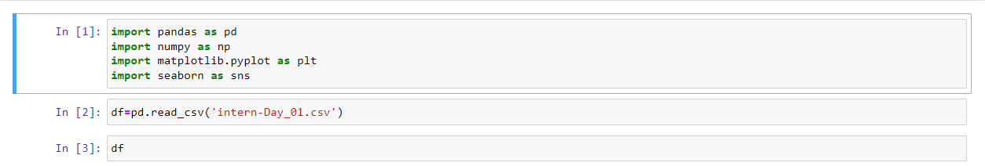
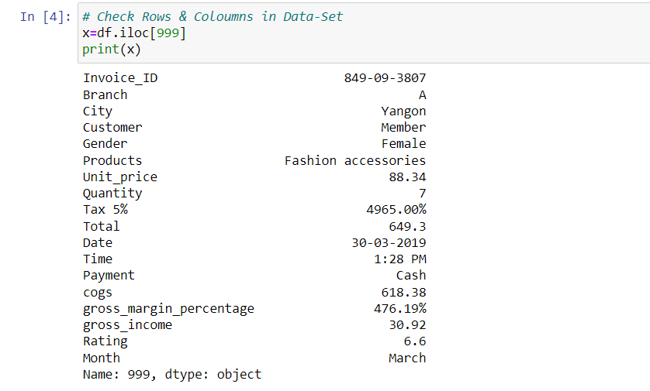
FINDING – IN Python
Here I am import the data in python
Python Libraries Using :-
Pandas
Matplotlib
Numpy
Seaborn
Folium
Here we use ‘iloc’ for Integer-based indexing and selection in pandas DataFrames.
5

Slide 7

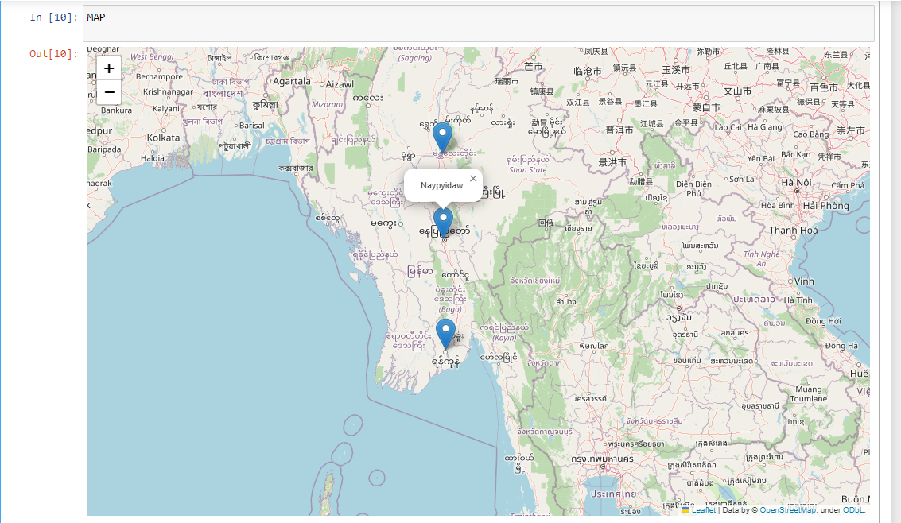

FINDING – 2
Throughput:
It is the no. of events happening per second. Let’s say the above metric is called throughput. Calculate 7 day rolling average.
CODE:
SELECT a.ds , a.event_count, avg(event_count) OVER(ROWS BETWEEN 6 PRECEDING AND CURRENT ROW) as
avg_7DAY_event_count FROM(select
ds , count(event) as event_count FROM
job_data GROUP BY ds ORDER BY ds) a
Here The dataset includes several cities, namely Yangon, Naypyidaw, and Mandalay
Standardize Data Format: Maintain a consistent and standardized format for the dataset, making it easier for users to analyze and compare different cities.
Increase Data Coverage: Include more cities in the dataset to provide a comprehensive overview of different regions.
Enhance Data Quality: Ensure the accuracy, reliability, and completeness of the data by validating and cross-checking the information from reliable sources.
6
7

Slide 8
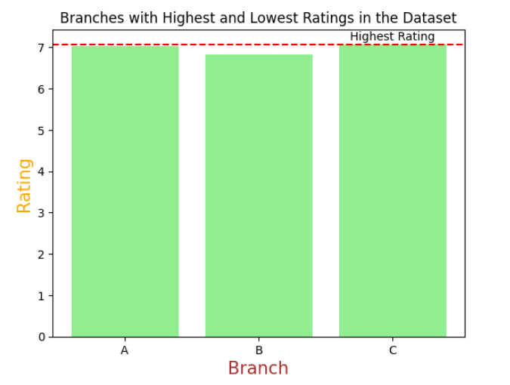
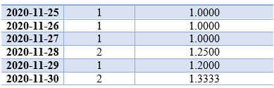
OUTPUT:
ds Event_count
avg_7day_event_count
In the Python code, we load the CSV file into a pandas DataFrame and calculate the mean rating for each branch. We then create a bar chart to visualize the mean ratings for each branch, highlighting the branch with the highest mean rating using a “red” dashed line and the label "Highest Rating." This presentation slide showcases branch ratings and emphasizes the branch with the highest rating.
Here, we see that, 7 day avg event count of all event is almost same.
7
8

Slide 9


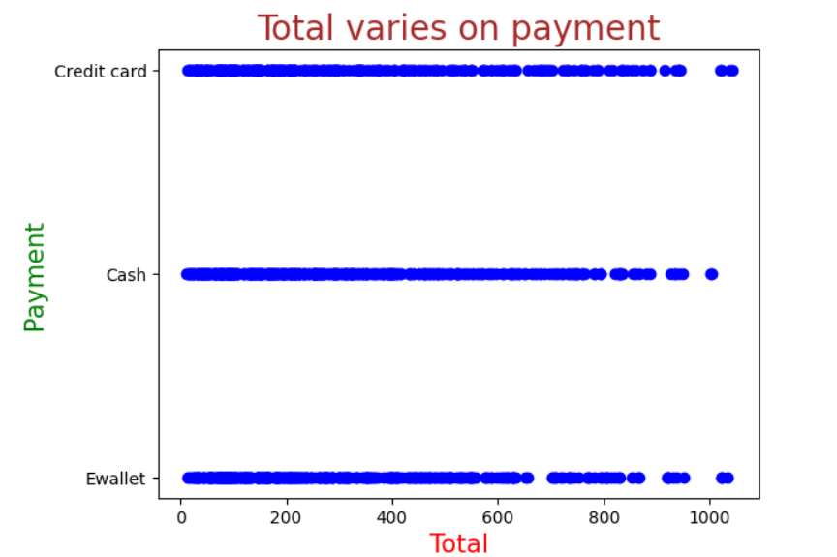


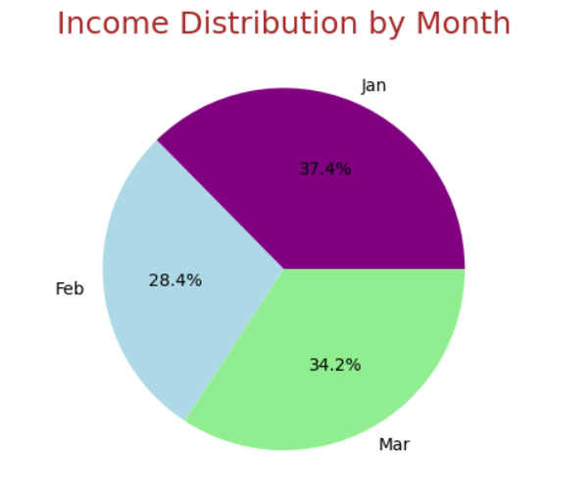
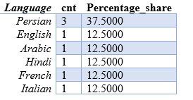


FINDING - 3
Percentage share of each language: Share of each language for different contents.
Calculate the percentage share of each language in the last 30 days
CODE :
SELECT
job_data.language , count(job_data.language) as cnt ,
COUNT(job_data.language)*100/ SUM(COUNT(job_data.language)) over() as Percentage_share
FROM job_data
GROUP BY job_data.language ORDER BY cnt desc;
OUTPUT:
In this analysis we plotted the relationship between 'Total' and 'Payment' using a scatter plot, highlighting the correlation between these variables.
Here I show income distribution with a colorful pie chart.
Analyzing income distribution by month using a visually appealing pie chart.
8
9

Slide 10


CONCLUSION
"The analysis involved importing data in Python and utilizing various libraries for data processing and visualization. The dataset included cities like Yangon, Naypyidaw, and Mandalay. Actions were suggested to standardize the data format, increase data coverage, and enhance data quality. Specific Python code snippets and data visualization techniques were employed to calculate mean ratings, visualize relationships between variables, and display income distribution. Overall, this analysis provides valuable insights into the data and facilitates better understanding and comparison of different cities."
9

Slide 11

Revolutionizing Business Analytics for the Modern Era with Power BI
Power BI is a game-changing business intelligence tool that simplifies data analysis and visualization. It seamlessly connects to various data sources, transforms raw data into valuable insights, and creates interactive dashboards and reports. Its intuitive interface and advanced analytics empower organizations to make informed decisions, discover hidden patterns, and foster growth and innovation.
10

Slide 12





The Problem
In India, Road Accidents are a significant concern, and several problems contribute to their occurrence. Here are some key problems related to road accidents in India :-
Reckless Driving:- Many accidents occur due to speeding, drunk driving, aggressive driving, and disregard for traffic rules and signals.
Lack of Awareness and Education:- Insufficient awareness campaigns and driver education programs contribute to a lack of understanding of safe driving practices.
Non-compliance with Safety Measures:- Non-usage of seat belts, helmets, and child restraints, along with inadequate pedestrian safety measures, contribute to the severity of accidents.
11

Slide 13
DESIGN
Steps taken :-
Connect to data sources.
Choose between importing or using Direct Query mode.
Transform and shape the data using Power Query Editor.
Create interactive visualizations like charts and graphs.
Combine visuals into reports and dashboards.
Apply data analysis techniques to gain insights
Tools used For Visualization :-
Power BI
12

Slide 14
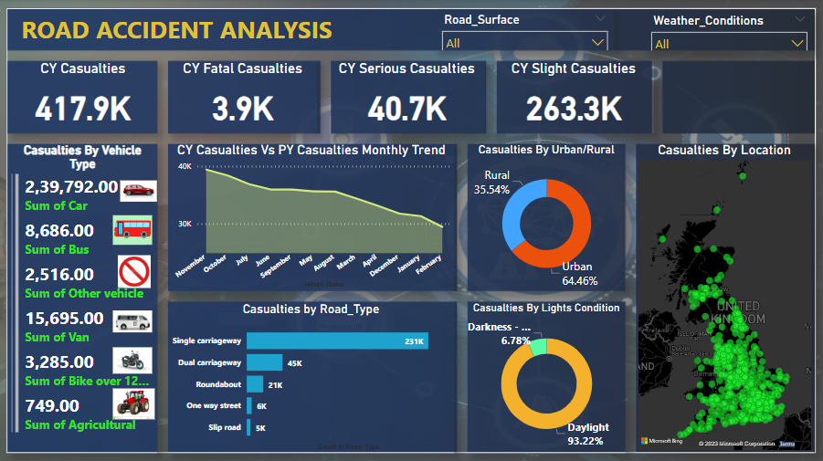
FINDING – 5
FINDING – IN Power BI (1)
Road Accident Analysis
OUTPUT : -
Here I am show the 1st Dashboard in Power BI
Road Accident Analysis: Understanding Casualties and Trends This section provides an overview of road accident casualties in the current year, helping us gain insights into the impact of accidents and trends.
11
13

Slide 15

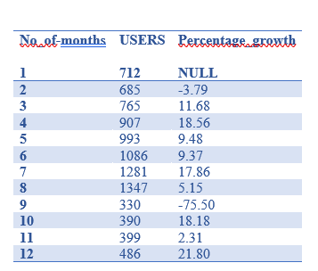
Monthly Comparison: Current Year (CY) vs. Previous Year (PY) Casualties By comparing the casualties between the current and previous year on a monthly basis, we can identify any significant changes or patterns in road accidents over time.
Urban vs. Rural: Examining Casualties in Different Areas Understanding the distribution of casualties in urban and rural areas allows us to explore the variations and factors contributing to accidents in different environments.
Vehicle Types: Impact on Casualties Analyzing casualties by different vehicle types helps us understand the role each vehicle category plays in road accidents and their impact on overall casualties.
Location Matters: Where Accidents Happen Investigating the specific locations where accidents occur provides valuable insights into high-risk areas, enabling us to focus on targeted measures for accident prevention and intervention.
Road Types: Analyzing Casualties by Road Characteristics By examining casualties based on different road types, we can assess the impact of road design and infrastructure on accident rates and severity.
Lighting Conditions: Shedding Light on Casualties Studying casualties under different lighting conditions helps us understand the influence of visibility on road accidents and emphasizes the importance of appropriate lighting measures for safety.
:
Here, We can see that growth of users.
12
14

Slide 16

CONCLUSION
In conclusion, this road accident analysis offers valuable insights into casualties, trends, and factors that contribute to accidents. By comprehending the distribution of accidents in urban and rural areas, the involvement of different vehicle types, the impact of specific locations and road types, and the influence of lighting conditions, stakeholders can implement focused measures to enhance road safety. This analysis serves as a foundation for policymakers and traffic authorities to take appropriate action and work towards reducing casualties and creating safer road environments for everyone.
15

Slide 17
The Problem
Violent Sexual Assault and Rape It is a grave crime that violates a person's bodily autonomy, dignity, and fundamental rights.
Highlighting the alarming rise of rape cases and the ongoing struggle to combat sexual assaults in India.
Shedding light on the importance of empowering survivors to speak up and break the silence surrounding rape incidents in India
Drawing attention to the individuals responsible for the country's rape crisis and emphasizing the urgency of exposing and bringing them to justice.
16

Slide 18

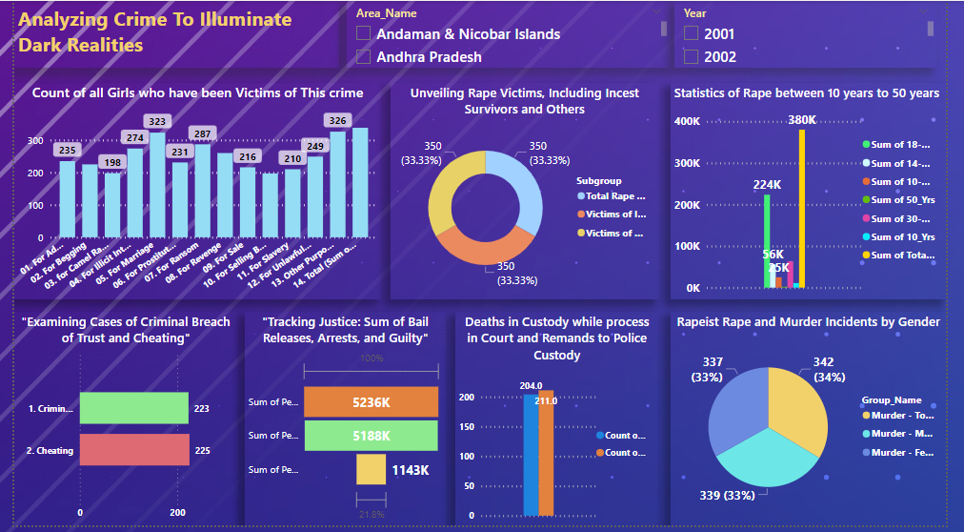

FINDING –IN Power BI (2)
Analyzing Crime To Illuminate Dark Realities
Here I am show the 2nd Dasboard in Power BI
22
17

Slide 19
OUTPUT :-
Trend analysis: Analyze the trend of rape incidents over the years for different age groups, geographical regions, or other relevant factors. Identify any significant changes or patterns in the data.
Geographic analysis: Explore the distribution of rape incidents across different states or regions in India. Compare the numbers and rates of incidents to identify high-risk areas or areas with improvements.
Victim demographics: Investigate the demographics of rape victims, including age, gender, and relationships with the perpetrators (e.g., incest survivors). Analyze any patterns or correlations to gain deeper insights.
Victim support and justice: Explore the outcomes of rape cases, including the number of arrests, bail releases, and guilty verdicts. Examine the process and timeline of justice to identify any potential areas of improvement.
18

Slide 20
Comparative analysis: Compare the rape statistics with other types of crimes, such as murder or cheating, to understand the overall crime landscape. Identify any correlations or differences between different types of crimes
Data visualization: Review the visualizations in Power BI dashboard to ensure they effectively represent the data and convey the intended message. Consider using different chart types, color schemes, or interactive features to enhance user understanding.
Data quality and completeness: Validate the accuracy and completeness of data. Ensure that all required fields are populated, and any missing or inconsistent values are addressed appropriately.

Slide 21

CONCLUSION
The conclusions drawn from the available data indicate that further analysis and investigation are necessary to fully comprehend the scope and nature of rape incidents, the demographics of the victims, the functioning of the judicial process, and the effectiveness of preventive measures. The data provided is limited and additional information and context are required to provide more conclusive insights and actionable recommendations for addressing the issue of rape.
Pr
20

Slide 22

Microsoft Excel is a spreadsheet program established by Microsoft in 1985. It enables users to organize, analyze, and manipulate data through grids of cells. It offers functions for calculations, data visualization through charts and graphs, and various tools for data formatting and analysis. Excel has become a vital tool for businesses and individuals working with data.
21

Slide 23
The Problem
Low Sales in Specific Categories: Identifying and improving sales in underperforming categories.
Ineffective Channel Performance: Improving the performance of channels that are not generating satisfactory sales.
Gender Bias in Sales: Addressing any significant differences in sales patterns between men and women.
Order Management Challenges: Streamlining the order management process to improve customer experience and minimize issues related to order fulfillment, refunds, returns, and cancellations
22

Slide 24
DESIGN
Tool used :- Excel
Steps Taken :-
Data Cleaning:
Removing duplicate values
Handling missing values
Sorting and Filtering:
Sorting data based on one or multiple columns.
Using advanced filters for more complex criteria.
Formulas and Functions:
using mathematical operators.
Creating custom formulas to perform specific calculations
Data Visualization:
Apply different chart types (bar, line, pie, scatter)
Format charts with titles, labels, styles
23

Slide 25
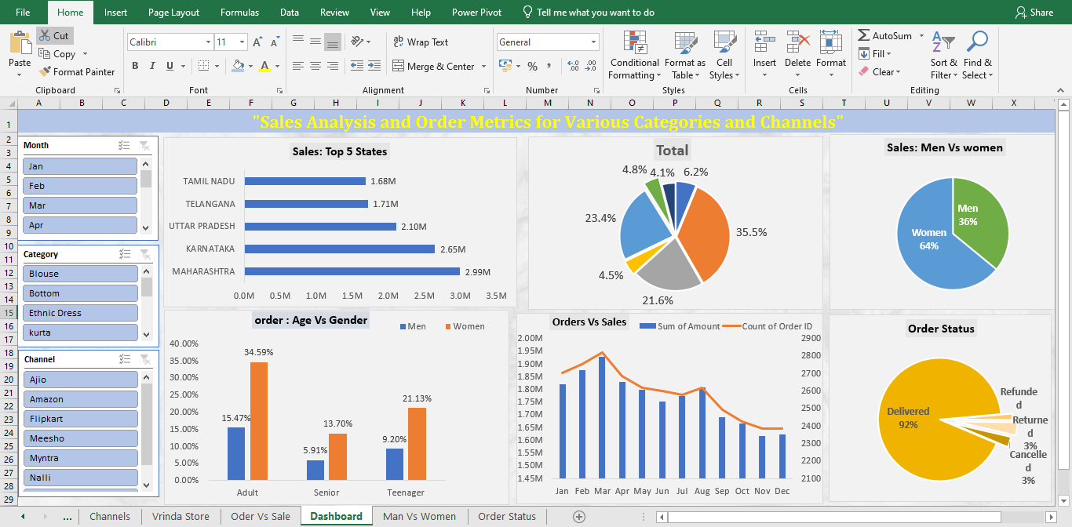
FINDING –IN Excel
Sales Analysis and Order Metrics for Final Year of Report 2023.
Here I am show the Dasboard in Excel
22
24

Slide 26
OUTPUT :-
Overall Sales Analysis: Calculate the total sales and profit for each month and visualize the trends using bar graphs. Identify the months with the highest sales and profit based on the graph.
Category Analysis: Calculate the total sales and profit for each category (blouse, bottom, ethnic dress, kurta, saree, set, top, western dress) and visualize the sales distribution using a slicer.
Channel Analysis: Calculate the total sales and profit for each channel (Ajio, Amazon, Flipkart, Myntra, Nalli, others) and visualize the sales distribution by channel using a slicer.
State Analysis: Calculate the total sales and profit for each state (Tamil Nadu, Telangana, Uttar Pradesh, Karnataka, Maharashtra) and visualize the sales distribution by state using a bar graph. Determine the top-performing states based on sales and profit figures.
25

Slide 27
OUTPUT :-
Gender Analysis: Calculate the total sales and profit for each gender (men & women) and visualize the sales distribution by gender using a pie chart. Identify the gender that contributes more to sales and profit by comparing the respective figures.
Order Status Analysis: Calculate the number and percentage of orders delivered, refunded, returned, and cancelled. Visualize the order status distribution using a pie chart. Identify the most common order status and evaluate its impact on sales and profit by comparing it to other statuses.
26

Slide 28



CONCLUSION
These insights provide valuable guidance for decision-making, enabling businesses to optimize their strategies, focus on high-performing categories, channels, and states, and effectively target the appropriate gender segment. Moreover, addressing any issues related to order status can contribute to improved customer experience and overall business performance.
27

Slide 29
APPENDIX
Here is the Link of All Project’s :- https://github.com/theNihal01/-Multifaceted-Data-Analysis-projects-Road-Accidents-Crime-And-Sales-Analysis-.git
28

Slide 30

Thannnkkk
yoouuu!!!

